Slide 1
Rethinking Guidance Information to Utilize Unlabeled Samples:
A Label Encoding Perspective
Yulong Zhang *, Yuan Yao * , Shuhao Chen , Pengrong Jin , Yu Zhang, Jian Jin, Jiangang Lu
2024.06

Slide 2
01
Problem & Background
02
Motivation & Methodology
03
Discussion & Application
04
Experiments

Slide 3
Problem
How to effectively utilize unlabeled samples to handle several label insufficient scenarios?
Source Domain
Target Domain
Knowledge
Semi-supervised Learning
Domain Adaptation
Label insufficient scenarios

Slide 4
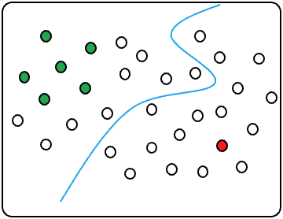
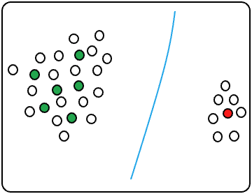
Background
Empirical Risk Minimization (ERM), which adopts the ground-truth label encodings of labeled samples to guide their learning. ERM is formulated as
Ground-truth label Encoding:
$$[1, 0, 0]$$
A vanilla extension of ERM to unlabeled samples is Entropy Minimization (EntMin), which utilizes the soft-label encodings of unlabeled samples to guide their learning. EntMin is formulated as
Soft-label Encoding:
$$[0.1, 0.7, 0.2]$$
However, EntMin emphasizes prediction discriminability while neglecting prediction diversity [1].
For unlabeled samples, is there more precise guidance information available???
[1] Cui, S., Wang, S., Zhuo, J., Li, L., Huang, Q., and Tian, Q. Towards discriminability and diversity: Batch nuclearnorm maximization under label insufficient situations. CVPR 2020.

Slide 5
Motivation
By analyzing the ERM’s learning objective, we find that:
The guidance information of the labeled samples in a specific category is the corresponding label encoding.
There is a one-to-one correspondence between label encoding and category.
Accordingly, those label encodings remain available for unlabeled samples !!!

Slide 6
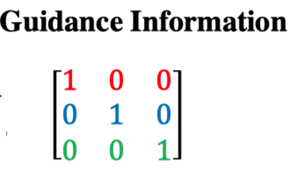
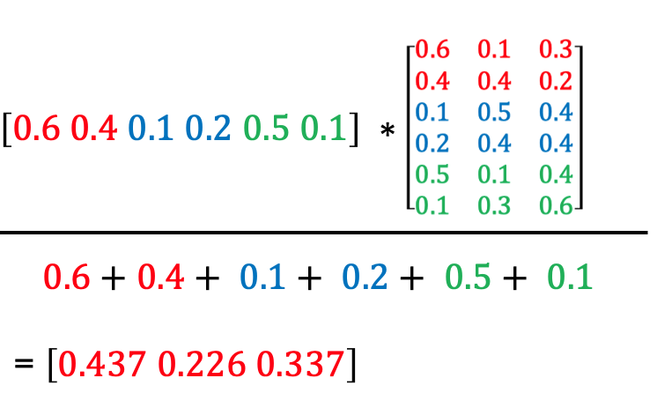
Motivation
How to utilize the label encodings to supervise the learning of unlabeled samples?
How to use?
Using unlabeled samples to estimate label encoding of each category !
Using the predicted category distribution of unlabeled samples to estimate label encodings in all categories.

Slide 7
Methodology
The prediction mean for category $c$ is defined as
Based on property (3) in Theorem 4.1, we find that ${\text{m}}_{\text{c}}^{\text{u}}$ could be regarded as an estimation for $e_{c}$. Accordingly, we formulate the LERM as
LERM can ensure the prediction discriminability and diversity to some extent.

Slide 8
Discussion
1. Connection between LERM and ERM
2. Connection between LERM and EntMin

Slide 9
Application
1. Semi-Supervised Learning (SSL)
2. Unsupervised Domain Adaptation (UDA)
3. Semi-supervised Heterogeneous Domain Adaptation (SHDA)

Slide 10
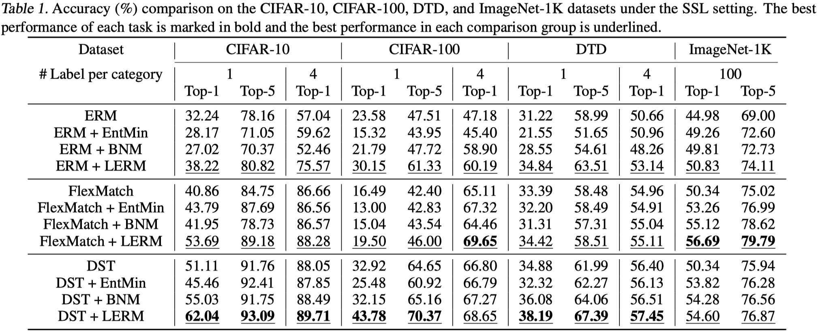
Experiments: Evaluation on SSL Tasks

Slide 11
Experiments: Prediction Discriminability Analysis
We can observe that ERM+EntMin and ERM+LERM obtain much lower entropy values than ERM. Those results show that both EntMin and LERM achieve good prediction discriminability.

Slide 12
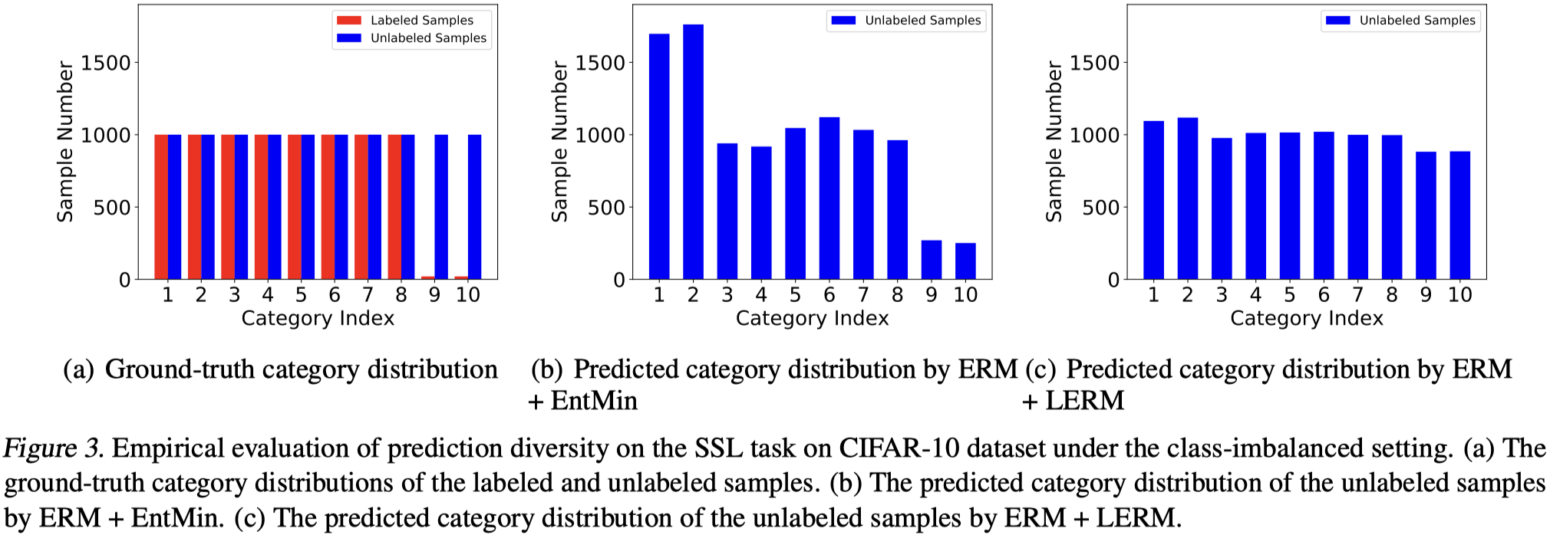
Experiments: Prediction Diversity Analysis
We rebuild the SSL task on the CIFAR-10 dataset into a category-imbalanced setting. We can see that compared with ERM + EntMin, ERM + LERM is less susceptible to the impact of category imbalance. Those results indicate that the LERM can effectively preserve prediction diversity even in category-imbalanced scenarios.

Slide 13
Thank you all for your time and participation!
Paper: https://arxiv.org/abs/2406.02862
Code: https://github.com/zhangyl660/LERM
Contact: yaoyuan.hitsz@gmail.com

